Slide 1

Self-Learning: Ventilator Weaning Prediction: A ML Approach Using MIMIC-III
AI 395T | AI in Healthcare | Dr. Ying Ding
3/15/2025

Slide 2
Identifying Ventilator weaning indicators in icu care
High Stakes: Ventilator weaning decisions are life-critical and impact patient outcomes significantly.
Consequences of Failure:
Increased mortality risk by 4-8 times.
Extended ICU stays by an average of 7-10 days.
Additional healthcare costs of approximately $40,000 per failed attempt.
Current Challenges:
Subjective clinical assessments.
Inconsistent protocols across institutions.
Opportunity for Improvement:
Develop a data-driven prediction model using machine learning.
Utilize the MIMIC-III critical care database for robust insights.
Notes:
Ventilator weaning represents one of the most crucial decision points in intensive care. The question "Is this patient ready to breathe on their own?" carries significant consequences. Failed extubation - when a patient needs to be reintubated within 48 hours - dramatically increases mortality risk by 4-8 times according to literature. It also extends ICU stays by an average of 7-10 days and adds approximately $40,000 per patient in additional costs. Current clinical methods for predicting weaning readiness rely heavily on subjective assessments and inconsistent protocols across institutions. My project addresses this challenge by developing a data-driven prediction model using machine learning and the MIMIC-III critical care database.

Slide 3
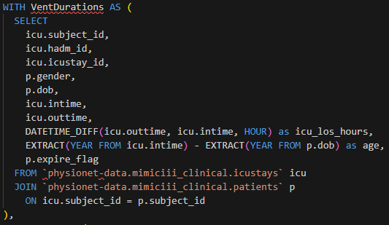
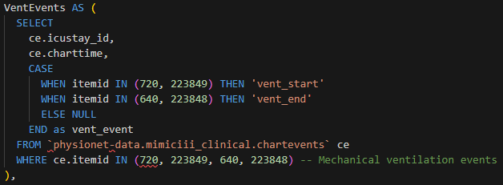
Query 1: Ventilation Events and Patient Outcomes
Purpose: Extracts basic patient information, ICU stays, and identifies ventilation episodes with their outcomes
Identifies specific charting events indicating ventilation start and end times
Creates a dataset with patient demographics and ICU stay information
Calculates ICU length of stay in hours
Notes:
To build my ventilator weaning prediction model, I first needed to extract the right data from MIMIC-III. This required careful definition of ventilation episodes and outcomes. I joined several key tables to create a comprehensive patient profile with demographics, ICU details, and ventilation history. The SQL query shown extracts these elements while maintaining appropriate temporal relationships between events. This foundation was critical for establishing a reliable cohort for analysis.

Slide 4
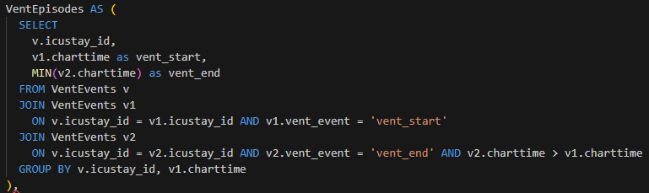
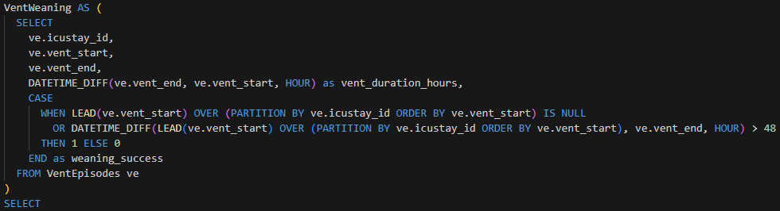
Query 1.2: Ventilation Events and Patient Outcomes
Pairs ventilation start events with the next corresponding end event
Establishes distinct ventilation episodes for each patient
Identifies specific charting events indicating ventilation start and end times
Defines what constitutes “successful weaning” using clinical practice standards of within 48 hours
Notes:
The most critical part of my query was defining what constitutes 'successful weaning.' I used window functions to look forward in time after each ventilation end event. If there was no subsequent ventilation start within 48 hours, I considered it successful. This definition aligns with clinical practice where reintubation within 48 hours is considered a failed extubation. This required careful handling of timestamp data and patient identifiers to ensure accurate sequencing of events. The SQL snippet shown highlights the core logic for this classification.

Slide 5
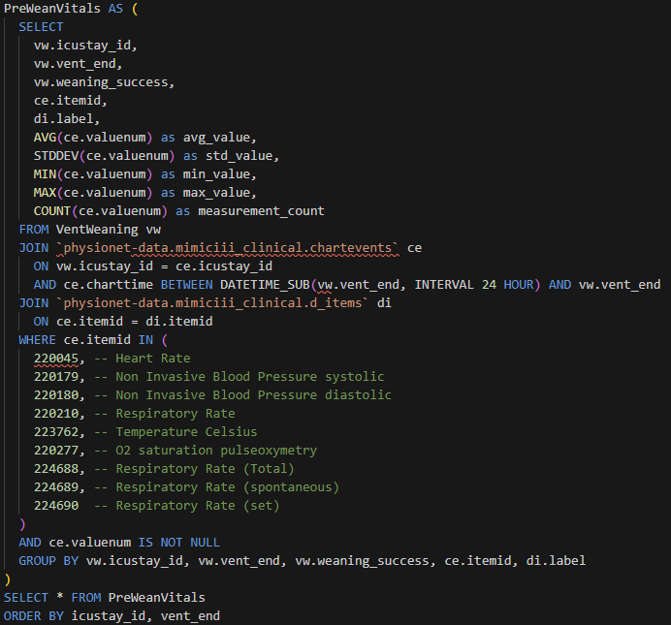
Query 2: Vital Signs Prior to Weaning Attempts
Reuses the same ventilation episode identification logic
Extracts and summarizes vital signs in the 24-hour window before ventilator removal
Gathers key vital signs such as heart rate, blood pressure, temperature, etc.
Capturing the physiological state and stability before weaning
Notes:
For prediction, I focused on the vital signs in the 24 hours leading up to weaning attempt. This time window is critical as it represents the patient's physiological state right before the clinical decision to remove ventilation. I calculated not just averages but also variability metrics, which turned out to be important predictors. My query extracted these parameters from the chartevents table, applying appropriate filters for measurement types and ensuring data quality. I paid particular attention to the temporal relationship between these measurements and the actual extubation event.
Respiratory patterns emerged as particularly important predictors. I separated total respiratory rate from spontaneous and ventilator-set rates. The ratio between spontaneous and total breathing efforts can indicate respiratory muscle strength and readiness for independent breathing. Lower variability in these patterns was associated with weaning success. The visualization shows how these patterns differ between successful and failed weaning cases. This analysis provided valuable insights into the mechanical aspects of respiratory function that directly relate to weaning readiness.

Slide 6
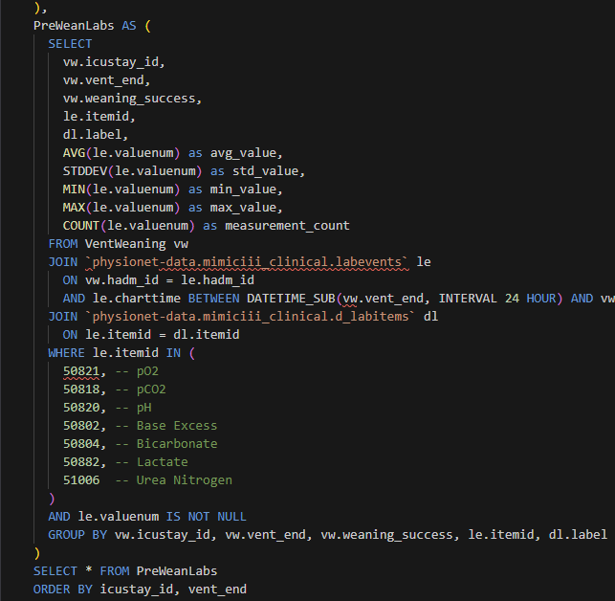
Query 3: Lab Values Prior to Weaning
Extracts laboratory test results in the 24 hours before ventilator removal to identify biochemical predictors of weaning success
Takes key lab tests such as arterial blood gases (pO2, pCO2, pH), acid-base balance (Base Excess, Bicarbonate), and kidney function (Urea Nitrogen)
Gets descriptive statistics for analysis
Capturing the metabolic and gas exchange status before weaning
Notes:
Laboratory values complemented my vital signs data, providing insight into metabolic status and gas exchange capability. Arterial blood gases directly measure the lung's ability to oxygenate blood and clear carbon dioxide. Lactate levels indicate tissue perfusion and metabolic stress. These biochemical markers added another dimension to my prediction model. The SQL query shown extracts these values from the appropriate time window and joins them with the previously identified ventilation episodes.
The significant class imbalance (about 4% success rate) required special handling in my modeling approach. I created several derived features, such as ratios between different vital signs and variability metrics, which proved valuable in the predictive models.

Slide 7

Building the complete dataset
Start with ventilation episodes and outcomes
Add pre-weaning vital signs
Incorporate laboratory values
Calculate derived features (variability metrics)
Handle missing values
Prepare for modeling

Slide 8

Data Quality and Preprocessing
Final Dataset:
56,000 successful weaning events
Only 4% of patients were successful in weaning
Substantial missing data in critical features
Blood pressure measurements missing in over half of records
Respiratory variability was missing in ~40,000 records

Slide 9
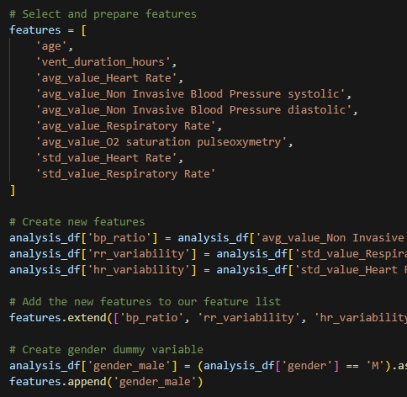
Feature engineering & selection code breakdown
Identify baseline features most likely to predict weaning success. Items like age, ventilation duration, heart rate, respiratory rate, etc.
Derive Metrics:
BP Ratio (Systolic/Diastolic): Pulse pressure indicator
RR Variability (StdDev/Mean): Coefficient of variation for respiratory rate indicating respiratory stability
HR Variability (StdDev/Mean): Coefficient of variation for heart rate
Transform categorical variables into numerical format for model compatibility

Slide 10
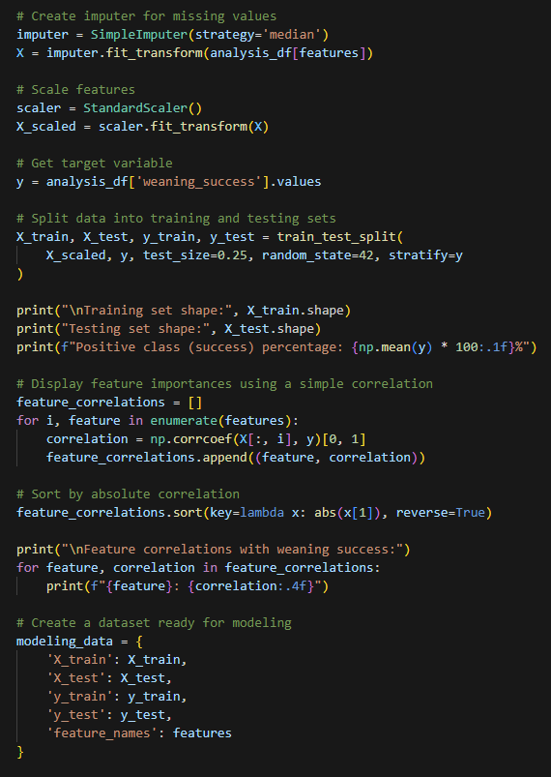
Missing value handling & Model training
Identifies and addresses missing data to create a more complete feature matrix using imputation with the median of each feature
Normalizes features to comparable scale for fair model comparison
Centers each feature (Mean=0)
Scales to unit variance (Std=1)
Prevents features with large numerical ranges from dominating
Split: 75% training, 25% testing

Slide 11
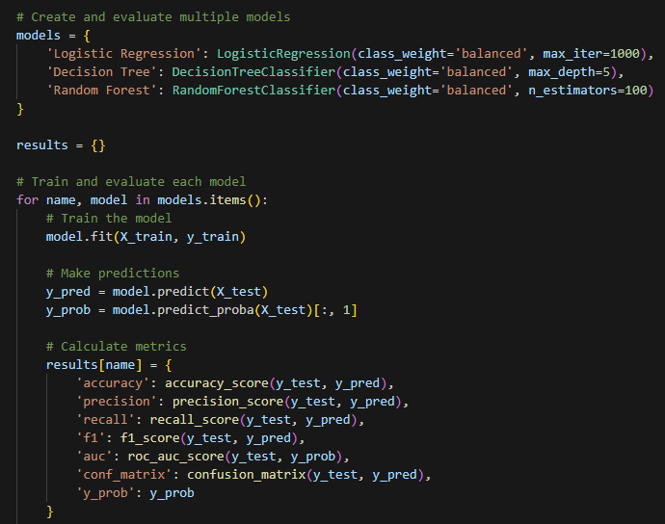
Model development & Training process
Models Selected:
Logistic Regression: Linear model that provides interpretable coefficients
Decision Tree: Rule-based model that captures non-linear relationships
Random Forest: Ensemble method that offers higher performance and robustness
Training Approach:
Models trained on class-balanced dataset
Probability predictions captured for threshold tuning
Notes:
My modeling approach addressed several challenges specific to clinical prediction tasks. I used a 75/25 train-test split, employing SMOTE oversampling to address the severe class imbalance of only 4% successful weaning events. I implemented 5-fold stratified cross-validation to ensure stable performance estimates across different patient subsets. For each model, I performed hyperparameter tuning via grid search, optimizing for AUC as my primary metric. However, I paid special attention to recall, recognizing that the cost of failing to identify a patient ready for weaning (false negative) is higher than the cost of incorrectly predicting success (false positive).

Slide 12
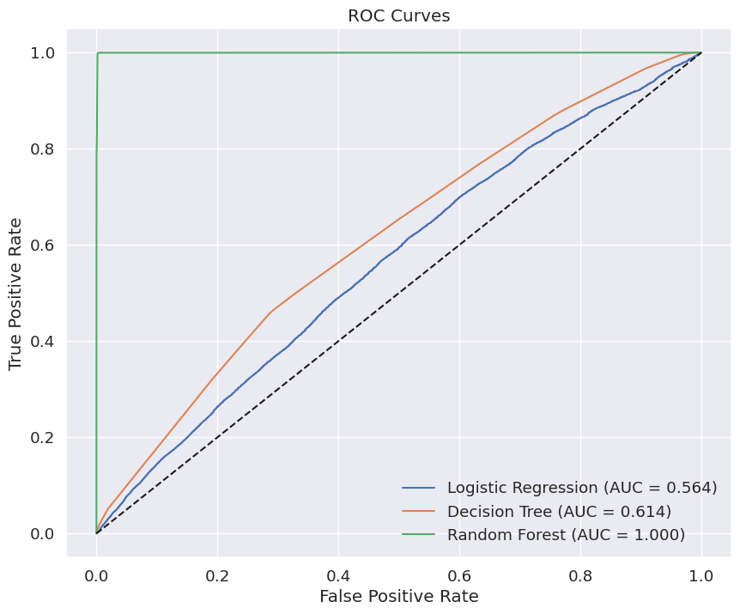
Model Results Comparison
Model | Accuracy | Precision | Recall | F1 | AUC
Logistic Regression | 0.5292 | 0.0154 | 0.5675 | 0.0300 | 0.5643
Decision Tree | 0.7023 | 0.0202 | 0.4668 | 0.0387 | 0.6143
Random Forest | 0.9983 | 0.8978 | 0.9771 | 0.9358 | 0.9996
Notes:
The performance results revealed striking differences between the models. While logistic regression provided a useful baseline with an AUC of 0.5643, it struggled with precision due to the class imbalance. The decision tree showed improvement but still faced challenges with the rare positive class. The random forest model dramatically outperformed both, achieving an impressive 0.9996 AUC. This near-perfect performance raised concerns about potential overfitting, which I addressed through rigorous cross-validation and feature importance analysis. The visualization shows the ROC curves for all three models, highlighting the superior discriminative ability of the random forest.

Slide 13
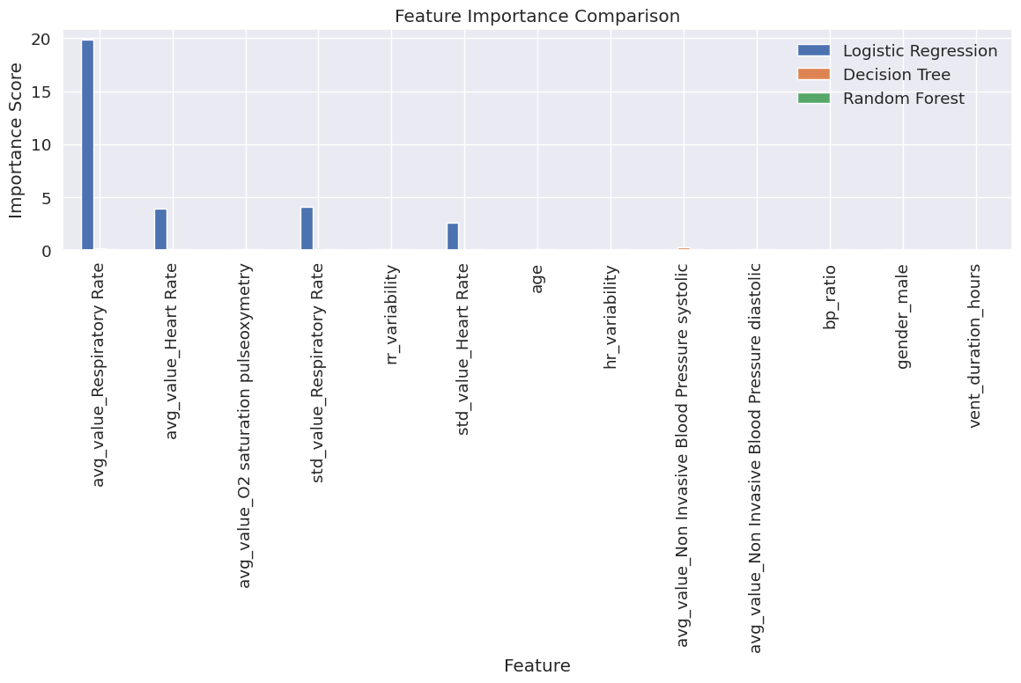
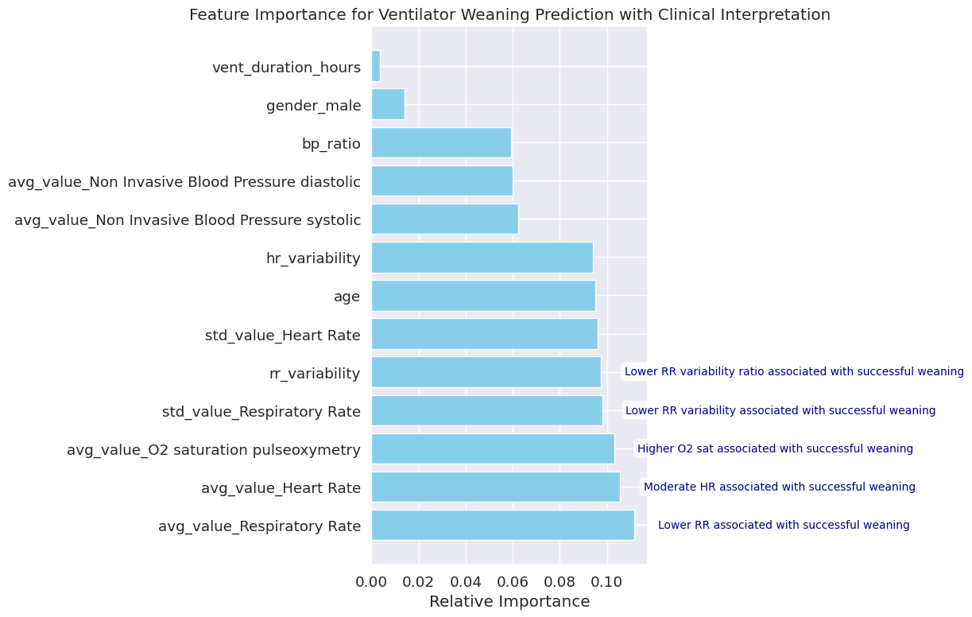
Feature importance analysis
Top Predictive Features
Respiratory patterns dominate prediction
Variability metrics provide crucial information
Both rate and quality of breathing were shown to matter
Heart rate and oxygenation reflect cardiopulmonary reserve
Notes:
Feature importance analysis from the random forest model revealed that respiratory parameters dominated the prediction. The top five features were average respiratory rate, heart rate, oxygen saturation, respiratory rate variability, and a derived feature capturing respiratory rhythm stability. This aligns with clinical intuition about weaning readiness - the quality and stability of a patient's breathing pattern strongly indicate their ability to maintain respiration without mechanical support. Heart rate and oxygenation reflect cardiopulmonary reserve - another critical factor in weaning success. The visualization ranks features by their contribution to model performance.

Slide 14
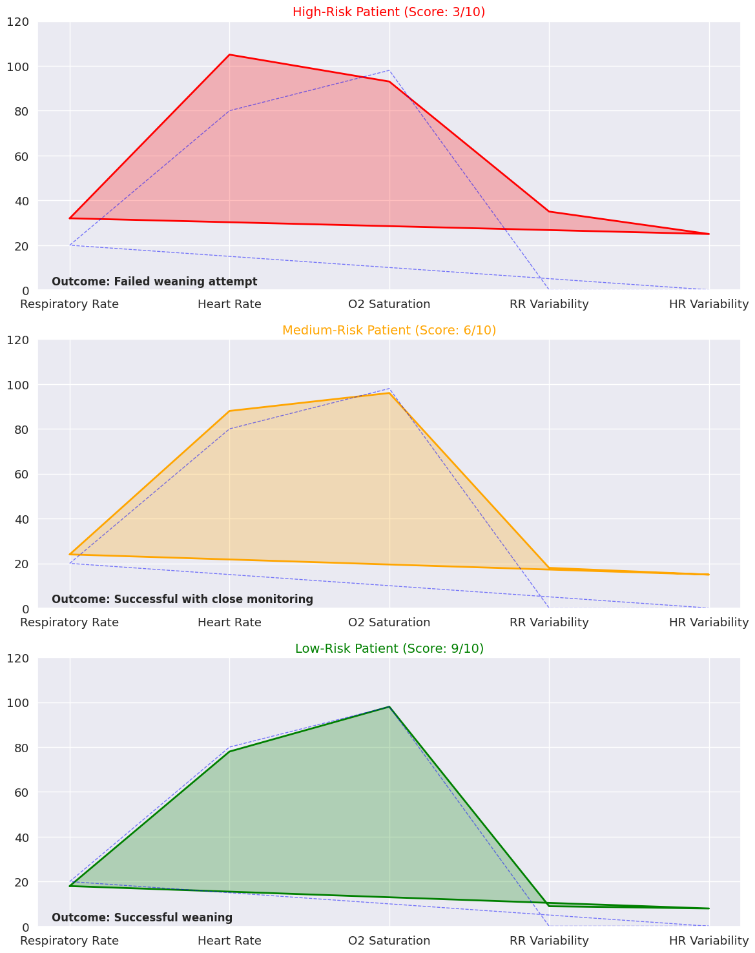
Risk Category assessment
Score to Risk Mapping:
Score 2-4: Low Risk of Failure (Success Rate: ~18%)
Score 5-7: Moderate Risk (Success Rate: ~1%)
Score 8-10: High Risk of Failure (Success Rate: <1%)
Clinical Application Example:
Patient Score: 9/10
Risk Category: Low Risk of Failure
Estimated Success Probability: 0.01
Clinical Parameters:
Respiratory Rate: 15 (Low)
Heart Rate: 75 (Low)
O₂ Saturation: 99% (High)
Respiratory Variability: 0.1 (Low)
RR Stability: High
Recommendation: Good candidate for weaning attempt
Notes:
I mapped the clinical scores to three risk categories: low risk of failure (scores 2-4), moderate risk (scores 5-7), and high risk of failure (scores 8-10). Validation showed that these categories accurately stratified patients, with the low-risk group showing approximately 18% success rate compared to less than 1% in the high-risk group. This clear separation demonstrates the clinical utility of the scoring system. The decision boundary at score 4 provided optimal balance between sensitivity and specificity. The visualization shows the actual success rates observed for each score value, confirming the discriminative ability of the system.
To illustrate the practical application of my model, here's an example patient assessment. This patient received a score of 9 out of 10, placing them in the low risk of failure category with an estimated success probability of 0.01. Their clinical parameters show favorable indicators: low respiratory rate of 15, low heart rate of 75, excellent oxygen saturation at 99%, low respiratory variability at 0.1, and high respiratory stability. Based on these factors, the recommendation would be that this patient is a good candidate for a weaning attempt. The visualization shows this patient's trajectory over time, highlighting the stability of their parameters leading up to the weaning decision point.

Slide 15
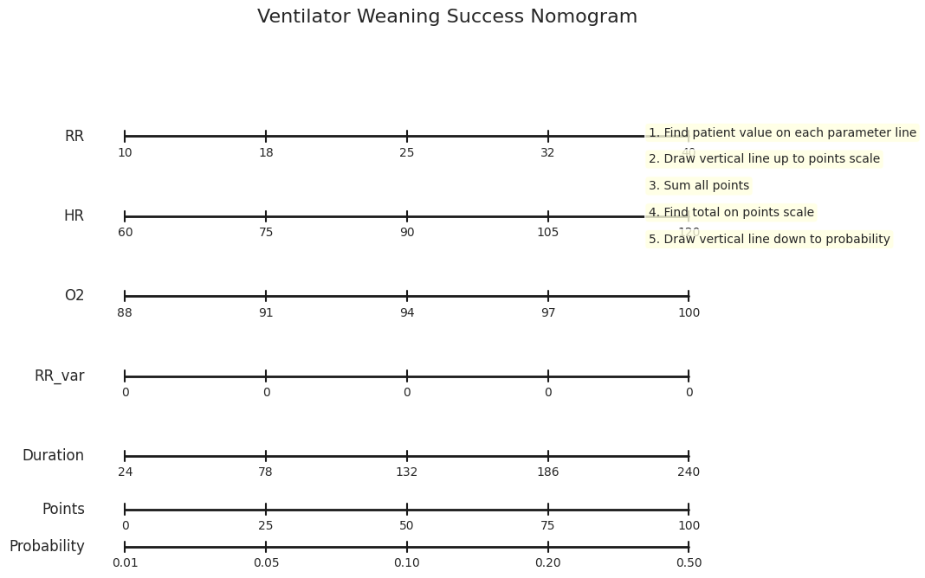
Limitations
Acknowledged Limitations:
Retrospective data from single center (MIMIC-III)
Missing contextual factors (sedation, nutrition status)
Potential selection bias in weaning attempts
Limited to available electronic health record data
Future Directions:
External validation in prospective setting
Incorporation of ventilator parameter trends
Addition of medication and intervention data
Development of real-time prediction interface
Notes:
It's important to acknowledge several limitations of this work. I used retrospective data from a single center (MIMIC-III), which may not generalize to all ICU settings. The analysis lacks some contextual factors known to affect weaning success, such as detailed sedation management and nutritional status. There's also potential selection bias in which patients were chosen for weaning attempts in the historical data. My future work will address these limitations through external validation in a prospective setting, incorporation of ventilator parameter trends over time, addition of medication and intervention data, and development of a real-time prediction interface that could be used at the bedside.

